Slide 1

‘LET’S TALK’
Developed by
SIMON BURNHAM
SENIOR EDUCATIONAL PSYCHOLOGIST
PORTSMOUTH EDUCATIONAL PSYCHOLOGY SERVICE
Revised 26/09/05
Notes:
This and the final page are the only ones not intended for the young person concerned; both are just for info! It’s a Powerpoint presentation so click, use the arrow or ‘page down’ keys to move on to the next page and get going with the program proper.

Slide 2


LET’S TALK
Click here to begin
Notes:
This program is not meant to replace a face-to-face discussion; it’s intended to supplement it in cases where children might be difficult to engage or might simply find a 1:1 verbal Q&A session hard going. There’s some evidence that boys in particular prefer NOT to have to face their conversation partner when thoughts and feelings are being discussed. This program offers a neat response to that issue if nothing else.
All the usual supplementary questions that an EP might want to ask along the way can be woven around LT. It doesn’t pretend to be comprehensive; it’s a skeleton! For this reason it doesn’t start by asking for the child’s name. You will surely have already found that information out before you start wanting to pick their brains in more detail! The logic of the program does assume that you’re using it at or very near the start of your meeting/conversation with a child, though.
The program works in a way that will be familiar to anyone with some experience of game play and internet use on a computer; running the cursor over objects will show if it’s worth clicking on them for more information – if it is, the cursor usually turns from an arrow into a hand. Even when there’s no click needed, passing the cursor over some objects will cause them to be highlighted and possibly make a sound. The intention is that once you’re up and running, the child does most of the clicking and cursor movement required, with prompts from you where needed.
Key words in the titles or questions on each screen are picked out in green throughout.
To help you (and the child concerned) know when there’s no point in continuing to click on a screen (ie when there’s no more information or questions ‘hidden away’), the last bit of text to appear is always in red – if you see red then you know that screen is complete.

Slide 3
BEFORE WE START
CLICK HERE
CONFIDENTIAL?
Notes:
This is a prompt to the EP to raise and discuss this issue, more than it is a prompt to the child or young person, who may not have a clue what it means. How this is dealt with is a matter for professional judgement.
Left-click the hand to move on.

Slide 4



ABOUT YOU
Your date of birth?
Your age?
Things you like to do in the evenings, weekends and holidays?
Notes:
Fairly obvious, and easy to answer, questions. Even though you are likely to know at least some of this already, some feedback from children when an earlier version of this program was being piloted suggested they liked to be asked some basic questions about themselves before being asked about their family. Which leads us on to the next page…
Left-click on the hand in the corner to move on and you’ll get a round of applause for your efforts. At the EP’s discretion, it might be better to turn off the sound when using this program with older children, who might find the sound effects a bit naff!

Slide 5
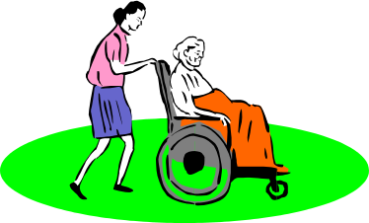


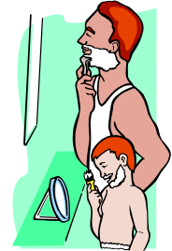
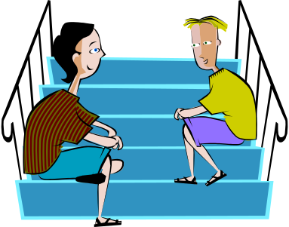
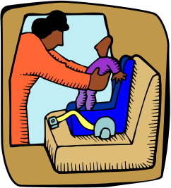




WHO LIVES WITH YOU AT HOME?
Notes:
Run the cursor over each picture and it is highlighted but nothing much else happens! It’s just a prompt to think about the question at the top.

Slide 6

YOUR FRIENDS
Who are your friends?
When do you see your friends?
What sorts of things do you like to do with your friends?
Notes:
As per previous pages.

Slide 7

WHAT THINGS ARE YOU GOOD AT IN SCHOOL?
Notes:
This slide and the next one originally had a list of curriculum subjects as prompts to help think about the question. Children’s responses showed clearly that they were mentioning what was on the list as much as, if not more than, things they actually felt they were good at. The list was putting words into their mouths so now it’s just the open question.
Click the hand to move on.

Slide 8

WHAT THINGS DO YOU FIND HARD AT SCHOOL?
Notes:
As for the previous slide.

Slide 9

ABOUT YOU
How would you describe yourself to someone who’d never met you but wanted to know what you’re really like?
Try doing it using only 5 or 6 words.
Notes:
Successive clicks bring up the two chunks of text, the final one being in red.
The words the child offers are good starting points for some PCP work. Each is an ‘emergent pole’ which will reward further discussion and investigation – beyond the scope of this program though.

Slide 10




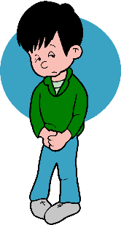













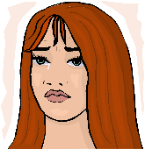






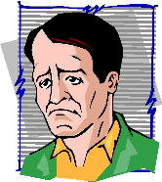

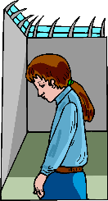


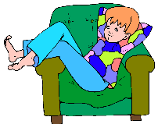








How do you feel?
Notes:
Most of the pictures are present on the screen to start with but several clicks bring up the rest until you get to the red text box that says the screen is complete.
The point of this screen is to prompt discussion about feelings. I often ask children: ‘Can you see a face/someone/a character here who looks like you feel when…’ or ‘how you usually feel…’. Many other questions are possible! And again this can be a springboard for PCP and other work as the descriptive words start rolling out…
Click the hand to move on.

Slide 11

WHO LOVES YOU?
WHO LIKES YOU?
Notes:
Nothing else is revealed by clicking on this screen. What you see is what you get. Much to discuss though.
You do get a nice sound if you move the cursor over the picture.

Slide 12

WHAT DO YOU THINK ABOUT SCHOOL?
If you had to give school a mark out of 10, what would it be?
0/10 would mean you feel awful, and 10/10 would mean you feel really good about it.
0 1 2 3 4 5 6 7 8 9 10
Have you ever felt better than that?
Have you ever felt worse?
Notes:
Successive clicks reveal the first two bits of text, then the child can click on the number line to answer.
Click again for the next question, and again for the last one. Clearly this screen lends itself to Brief Therapy-type scaling questions; other questions might feel pertinent before moving on.

Slide 13

WHAT COULD YOU DO...
TO MAKE THINGS BETTER FOR YOU AT SCHOOL?
HOW WILL YOU DO IT?
Notes:
Self explanatory

Slide 14

HELP?!
Do you get any extra help with anything at school?
Would you like more help with anything?
YES PLEASE
NO THANKS
Notes:
Again, clicking brings the text up. The red box signals that the screen is complete. Click on one of the boxes and you get taken to a different page depending on which one you chose.

Slide 15

WHAT WOULD YOU LIKE HELP WITH?
Notes:
If you clicked ‘yes’ to the ‘more help?’ question then you come here before being taken to the final, ‘Any Questions?’ page.

Slide 16

ANY QUESTIONS?
Is there anything you’d like to ask now, or anything else I should know?
Thanks very much for all that information!
Click here to finish
Notes:
If you don’t want more help, you get taken straight here, where clicking again brings the text up. This is the last page.

Slide 17
This PowerPoint presentation can be freely distributed, copied and adapted by anyone aiming to use it with children and young people.
If you do use it or change it in any way it would be helpful if you could acknowledge its source and send comments or feedback to
simon.burnham@portsmouthcc.gov.uk
Notes:
Just for info, and a request for feedback!

